Slide 1
The Advanced Derivative Session 6-7
Course : MATH 6031 – Calculus
Year : 2021

Slide 2

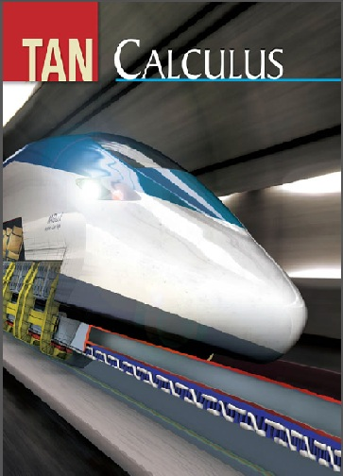
These slides have been adapted from: Dale Varberg, Edwin Purcell, Steve Rigdon. 2007. Calculus. Prentice Hall. ISBN: 978-0132306331. Soo.T.Tan. Calculus. 2010. Brooks/Cole. ISBN-13: 978-0-534-46579-7
Acknowledgement

Slide 3

Learning Objectives
LO 2:
Explain the properties of derivative to describe geometric and physical problems, and other applications.

Slide 4
Content
1
Higher-Order Derivatives
2
Implicit Differentiation
3
Related Rates

Slide 5
Higher-Order Derivatives

Slide 6
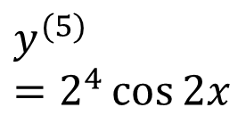
Example 1
$$y=\sin{2x}$$
𝑦=sin⁡2𝑥
$$y^{′}=2\cos{2x}$$
𝑦^′=2 cos⁡2𝑥
$$y^{′′}=−2^{2}\sin{2x}$$
𝑦^′′=−2^2 sin⁡2𝑥
$$y^{′′′}=−2^{3}\cos{2x}$$
𝑦^′′′=−2^3 cos⁡2𝑥
$$y^{(4)}=2^{4}\sin{2x}$$
𝑦^((4))=2^4 sin⁡2𝑥
$$y^{(5)}=2^{4}\cos{2x}$$

Slide 7

Example 2 (1/2): Velocity and Acceleration
An object moves along a horizontal coordinate line in such a way that its position at time t is specified by
$$s=t^{3}−12t^{2}+36t−30$$
Here s is measured in feet and t in seconds.
Velocity
Velocity, $v\left(t\right)=\frac{ds}{dt}=3t^{2}−24t+36$
Velocity, 𝑣(𝑡)=𝑑𝑠/𝑑𝑡=3𝑡^2−24𝑡+36
Positive Velocity
Object moving to the right
$v=0$ at $t=2$ and $t=6$
𝑣=0 at 𝑡=2 and 𝑡=6
$v>0$ when $\left(t−2\right)\left(t−6\right)>0$. That is in interval $(−∞,2)∪(6,∞)$
𝑣>0 when (𝑡−2)(𝑡−6)>0. That is in interval (−∞,2)∪(6,∞)

Slide 8
Example 2(2/2): Velocity and Acceleration
Negative Velocity
Object moving to the left
$v<0$ when $\left(t−2\right)\left(t−6\right)<0$. That is in interval $(2,6)$
𝑣<0 when (𝑡−2)(𝑡−6)<0. That is in interval (2,6)
Positive Acceleration
$a=\frac{dv}{dt}=6t −24>0$ will happen when $t>4$
𝑎=𝑑𝑣/𝑑𝑡=6𝑡 −24>0 will happen when 𝑡>4

Slide 9
Explicit Functions
Sometimes, however, a function is defined implicitly by an equation F(x,y).
For example, the equation
In fact, if we solve the equation for y in terms of x,
we obtain the explicit representation
$$y=f(x)=\frac{\cos{x}−1}{x^{2}+1}$$
In fact, if we solve the equation for y in terms of x,
we obtain the explicit representation
𝑦=𝑓(𝑥)=(cos⁡𝑥−1)/(𝑥^2+1)
x²y + y – cos x + 1 = 0
defines y as a function of x.

Slide 10
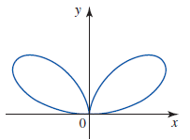
Implicit Differentiation
How about the equation 4x⁴ + 8x²y² – 25x²y + 4y⁴ = 0 whose graph is shown in Figure?
The Vertical Line Test shows that the equation does not define y as a function of x.
So how do we go about computing dy/dx in this case?
Implicit differentiation

Slide 11
Implicit Differentiation Method
Suppose that a function y = f(x) is defined implicitly via an equation in x and y. To compute dy/dx:
Differentiate both sides of the equation with respect to x. Make sure that the derivative of any term involving y includes the factor dy/dx.
1
2
Solve the resulting equation for dy/dx in terms of x and y.

Slide 12
Example 3
If y⁴ – 2y³ +x³y² – cos x = 8
then

Slide 13
Example 4
Find an equation of the tangent line to the graph x² + y² = 4 at the point (1, √3)
Differentiating both sides with respect to ,
The slope of the required tangent line is
An equation of the tangent line is

Slide 14
Related Rates Problem
Guidelines for Solving a Related Rates Problem
1
Draw a diagram, and label the variable quantities.
2
Write down the given values of the variables and their rates of change with respect to t
3
Find an equation that relates the variables.
4
Differentiate both sides of this equation implicitly with respect to t.
Replace the variables and derivative in the resulting equation by the values found in Step 2, and solve this equation
5

Slide 15
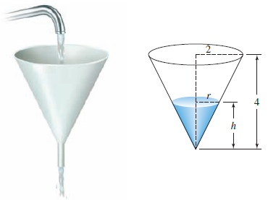
Example 5 (1/3)
Water is poured into a conical funnel at the constant rate of 1 in.³/sec and flows out at the rate of 0.5 in.³/sec. The funnel is a right circular cone with a height of 4 in. and a radius of 2 in. at the base.
How fast is the water level changing when the water is 2 in. high?

Slide 16
Example 5 (2/3)
Step 1
Let
V = the volume of the water
Step 2
We are given that
Step 3
The volume of water in the funnel is
$$V=\frac{1}{3}πr^{2}h$$
using similar triangles
$$\frac{r}{h}=\frac{2}{4} \text{or} r=\frac{h}{2}$$
we obtain
$$V=\frac{1}{12}πh^{3}$$
The volume of water in the funnel is
𝑉=1/3 𝜋𝑟^2 ℎ
using similar triangles
𝑟/ℎ=2/4 " or " 𝑟=ℎ/2
we obtain
𝑉=1/12 𝜋ℎ^3
h = the height of the water
r = the radius of the surface of the water
$$\frac{dV}{dt}=1−\frac{1}{2}=\frac{1}{2}$$
𝑑𝑉/𝑑𝑡=1−1/2=1/2
and are asked to find dh/dt when
h = 2

Slide 17
Example 5 (3/3)
Step 4
Differentiating this last equation implicitly with respect to t, we obtain
$$\frac{dV}{dt}=\frac{1}{4}πh^{2}\frac{dh}{dt}$$
Differentiating this last equation implicitly with respect to t, we obtain
𝑑𝑉/𝑑𝑡=1/4 𝜋ℎ^2 𝑑ℎ/𝑑𝑡
Step 5
Finally, substituting dV/dt = ½ and h = 2 into this equation gives
$$\frac{dh}{dt}=\frac{1}{2π}≈0.159$$
and we see that the water level is rising at the rate of 0.159 in./sec.
Finally, substituting dV/dt = ½ and h = 2 into this equation gives
𝑑ℎ/𝑑𝑡=1/2𝜋≈0.159
and we see that the water level is rising at the rate of 0.159 in./sec.

Slide 18
Dale Varberg, Edwin Purcell, Steve Rigdon. 2007. Calculus. Prentice Hall. ISBN: 978-0132306331.
Dale Varberg, Edwin Purcell, Steve Rigdon. 2014. Calculus Early Transcendentals. Pearson New International Edition. ISBN: 978-1-292-04268-8
Soo.T.Tan. 2010. Calculus. Brooks/Cole. ISBN-13: 978-0-534-46579-7

